Slide 1

Enhancing crop recommendation systems with explainable artificial intelligence
Motilal Nehru National Institute of Technology Allahabad
Under the guidance of Dr. Pragya Dwivedi
By: Group 32
Tejash Pratap Singh (20214057) Yash Kumar Nayak (20204072)
Shashi Raj (20214263)
Shrinivash (20204026)
Course Code: CS16201

Slide 2
OUTLINE
Introduction
Problem Statement
Literature Survey
Implemented Work
Experimental Results
Conclusion
Future Aspects
References

Slide 3
Introduction
Encompassing agricultural data for multiple crops across various states in India from 1997 to 2020.
Comprising key features for crop yield prediction: crop types, crop years, seasons, states, areas under cultivation, production quantities, annual rainfall, fertilizer usage, pesticide usage, and calculated yields

Slide 4
Introduction
Use Cases:
Revealing valuable insights for agricultural analysts, researchers, and data scientists
Delving into the relationship between various agronomic factors and crop productivity
Paving the way for the development of robust machine learning models for crop yield prediction
Identifying trends in agricultural production
Target Audience:
Agricultural analysts, researchers, data scientists, and machine learning practitioners

Slide 5
Data Preprocessing
In this phase, the input data, which includes crop types, crop years, seasons, states, areas under cultivation, production quantities, annual rainfall, fertilizer usage, pesticide usage, and calculated yields.
Data preprocessing is a crucial step in data mining that involves transforming raw data into a clean, organized, and analytically ready format. Here's a brief overview of the steps involved:
Data Cleaning: This step involves handling missing values, noisy data, and inconsistencies. Techniques such as imputation, removing duplicates, and correcting errors are used to clean the data.
Data Integration: Data integration involves combining data from multiple sources into one cohesive dataset. This may include resolving schema conflicts, data format inconsistencies, and merging datasets with common identifiers.
Data Transformation: Data transformation involves converting raw data into a format suitable for mining. This includes normalization (scaling data to a standard range), discretization (converting continuous attributes into categorical ones), and feature engineering (creating new features from existing ones).

Slide 6
Data Preprocessing
Data Reduction: Data reduction techniques aim to reduce the dimensionality of the dataset while preserving its integrity and relevant information. Techniques such as feature selection (selecting the most relevant features) and feature extraction (transforming data into a lower-dimensional space) are commonly used.
Data Discretization: Discretization involves dividing continuous attributes into intervals or bins. This can help simplify the data and make it easier to analyze, especially for algorithms that require categorical inputs.
Normalization and Standardization: These techniques are used to scale numerical attributes to a standard range or distribution. Normalization scales data to a range between 0 and 1, while standardization transforms data to have a mean of 0 and a standard deviation of 1.
Data Sampling: Sampling techniques such as random sampling or stratified sampling may be employed to reduce the size of the dataset while retaining its representativeness.

Slide 7
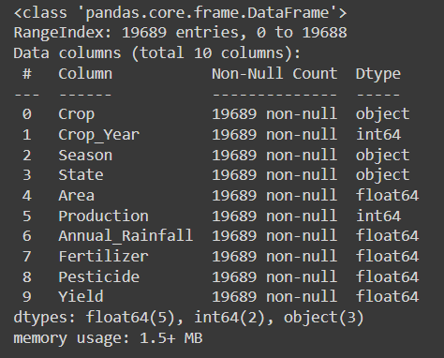
Data Loading and Cleaning
Importing libraries
Loading the dataset
Cleaning the dataset: removing duplicates and calculating derived values

Slide 8
Random Forest
Random Forest is a versatile ensemble learning method used for classification and regression tasks. It operates by constructing a multitude of decision trees during training and outputting the mode (classification) or mean prediction (regression) of the individual trees.
Ensemble Learning: Combines the predictions of multiple individual models (decision trees) to improve accuracy and robustness.
Bagging: Utilizes bootstrap aggregating to create diverse subsets of the training data for each tree, reducing overfitting.
Random Feature Selection: Randomly selects a subset of features at each node split, introducing further diversity and preventing dominance by any single feature.
Voting (Classification) or Averaging (Regression): Aggregates the predictions of individual trees to produce the final output.

Slide 9
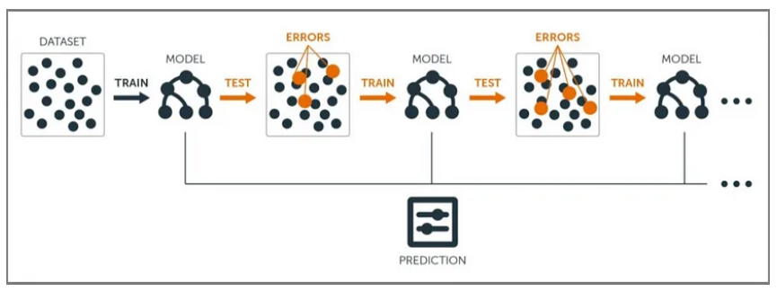
Gradient Boosting
Gradient Boosting is an supervised machine learning algorithm used for classification and regression problems. It is an ensemble technique which uses multiple weak learners to produce a strong model for regression and classification.

Slide 10
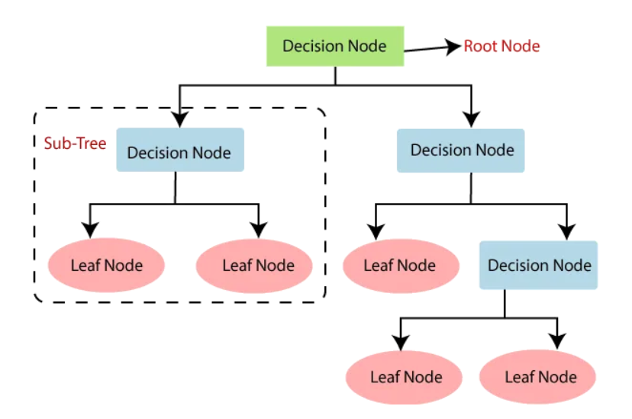
Decision Trees
A decision tree is a non-parametric supervised learning algorithm. It has a hierarchical, tree structure, which consists of a root node, branches, internal nodes and leaf nodes.
Decision Trees are the foundation for many classical machine learning algorithms like Random Forests, Bagging, and Boosted Decision Trees.

Slide 11
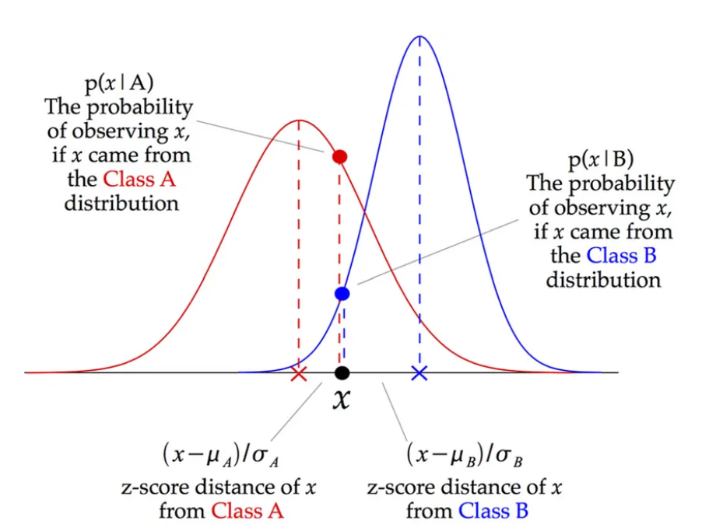
Gaussian Naive Bayes
Gaussian Naive Bayes is based on Bayes’ theorem, which describes the probability of an event, based on prior knowledge of conditions that might be related to the event. In the context of machine learning, it is a probabilistic classifier that assumes the features follow a Gaussian (normal) distribution. The “naive” part comes from the assumption of independence between features, which simplifies the calculation of probabilities.

Slide 12
Workflow Scheduling
Workflow Scheduling refers to the mapping of tasks to the resources on a cloud platform.
This work focuses on finding a schedule to execute a workflow on an IaaS cloud such that total cost and total idle rate are minimized while meeting the user defined deadline constraint.
A schedule is represented as Π = (V^{A}, T^{S}, T^{F} ) and R = (T_{S}, T`E, T`HS, T`HE) and the objective is f(Π, R) = (total cost, total idle rate).
The total cost consists of two parts: the running cost and the leasing cost.

Slide 13
Workflow Scheduling Algorithm
This approach is composed of 5 stages as described below :
T2FA - Establish the mapping of tasks to resources.
DOBS – It optimizes the results by reducing leasing cost and unnecessary idle time.
IHSH – It makes the scheduling compact by switching the VMs from idle state to hibernation state.

Slide 14
Implemented Work
We have implemented LIME and SHAP in our mini project.
Implementation is done in python.
Results are obtained by running different dataset against the implemented algorithms.

Slide 15
LIME (Local Interpretable Model-Agnostic Explanations)
LIME proposes to focus on interpreting locally instead of providing a global model interpretation. We can zoom in on a datapoint in a model and then can find in detail which features impacted the model to reach certain conclusion.
Local: Explains why a single data point was classified as a specific class
Model-agnostic: Treats the model as a black-box. Doesn’t need to know how it makes predictions
LIME is a good tool to understand the black box models .

Slide 16
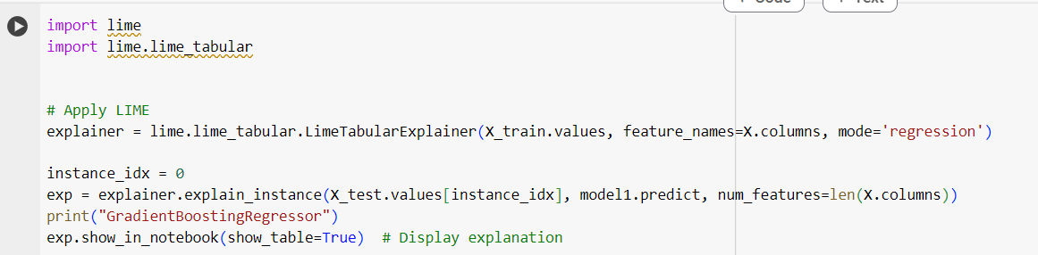
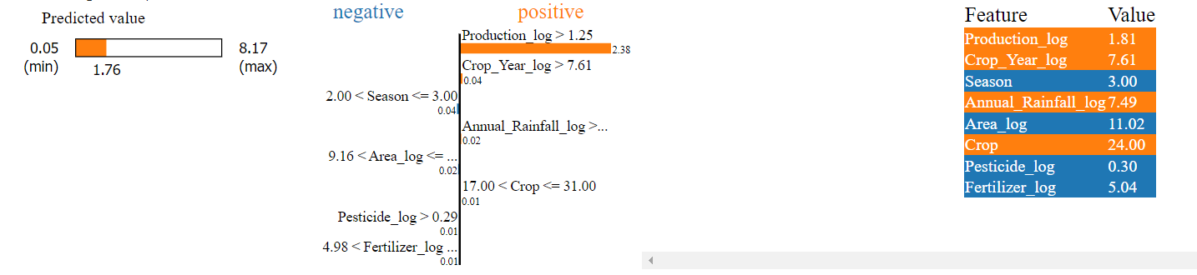
LIME on Gradient Boosting Regressor

Slide 17
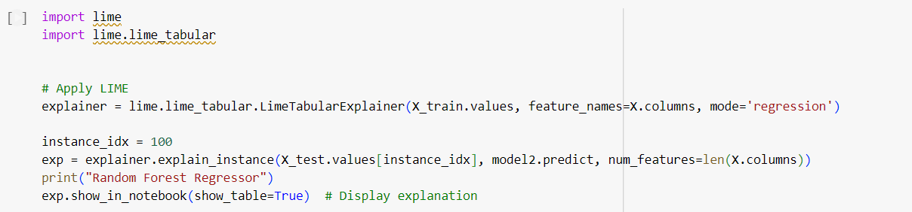
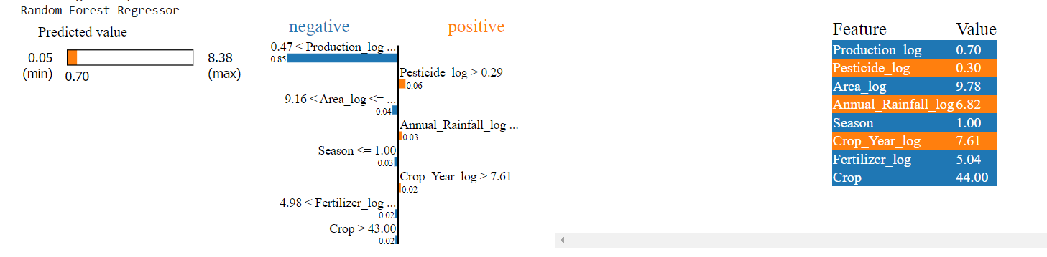
LIME on Random Forest

Slide 18

Mean Absolute Error
Mean Absolute Error(MAE) is the mean size of the mistakes in collected predictions. We know that an error basically is the absolute difference between the actual or true values and the values that are predicted. The absolute difference means that if the result has a negative sign, it is ignored.
MAE takes the average of this error from every sample in a dataset and gives the output.

Slide 19
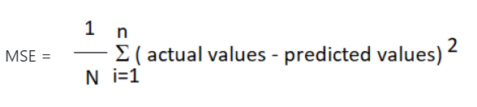
Mean Squared Error
The Mean Absolute Error is the squared mean of the difference between the actual values and predictable values.
.

Slide 20
R Squared
This metric gives an indication of how good a model fits a given dataset. It indicates how close the regression line (i.e the predicted values plotted) is to the actual data values. The R squared value lies between 0 and 1 where 0 indicates that this model doesn't fit the given data and 1 indicates that the model fits perfectly to the dataset provided.
.

Slide 21
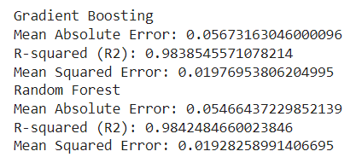
Result of GB and RF

Slide 22
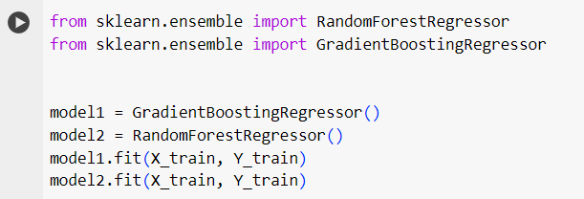
Model Evaluation
Splitting the dataset into training and testing sets.
Training and evaluating various regression models, such as Random Forest and Gradient Boosting.

Slide 23
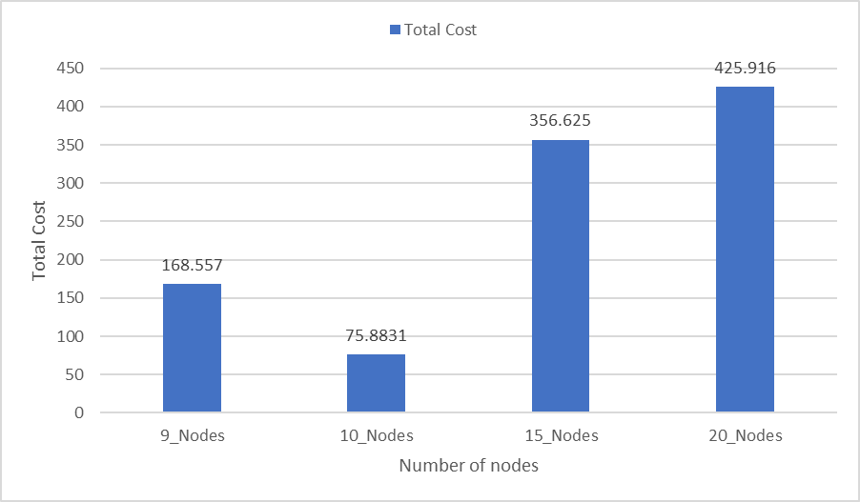
Experimental Results
The implemented algorithms have been run and provided results for various workflow DAGs. Plots have been made to show the running time and total cost of many workflows.
Fig.4. Total Cost of different DAGs with different nodes

Slide 24
Conclusion
In conclusion, ET2FA (Enhanced Task Type First Algorithm) proves to be a promising hybrid heuristic algorithm for deadline-constrained workflow scheduling in the cloud.
This algorithm efficiently addresses the challenge of scheduling tasks within tight time constraints while optimizing resource utilization.
One of the key strengths of ET2FA is assigning types to tasks based on their predecessor and successor tasks which then helps in more efficient and compact scheduling of all the tasks.
By leveraging a combination of heuristics and task type compatibility analysis, ET2FA minimizes the chances of scattered scheduling and reduces the risk of missing deadlines.

Slide 25
Future Aspects
While ET2FA performs well under normal and static workflow conditions, it would be valuable to evaluate its robustness in extreme scenarios, such as high task arrival rates or resource failures.
Considering the dynamic nature of cloud environments, continuous optimization techniques could be integrated into ET2FA to further enhance its adaptability and responsiveness.
Integrating fault tolerance and power efficiency methodologies into ET2FA, testing and evaluating the outcomes to enhance the cloud computing model.

Slide 26
References
“Z. Sun, B. Zhang, C. Gu, R. Xie, B. Qian and H. Huang, "ET2FA: A Hybrid Heuristic Algorithm for Deadline-constrained Workflow Scheduling in Cloud," in IEEE Transactions on Services Computing, 2022”
“E.-K. Byun, Y.-S. Kee, J.-S. Kim, and S. Maeng, “Cost optimized provisioning of elastic resources for application workflows,” Futur. Gener. Comp. Syst., vol. 27, no. 8, pp. 1011–1026, 2011. “
”A. Song, W.-N. Chen, X. Luo, Z.-H. Zhan, and J. Zhang, “Schedul- ing workflows with composite tasks: A nested particle swarm optimization approach,” IEEE Trans. Serv. Comput., vol. 15, no. 2, pp. 1074–1088, 2020.”
“Deldari, A., Naghibzadeh, M. & Abrishami, S. CCA: a deadline-constrained workflow scheduling algorithm for multicore resources on the cloud. J Supercomput 73, 756–781 (2017).”
“M. A. Rodriguez and R. Buyya, “Deadline based resource pro- visioning and scheduling algorithm for scientific workflows on clouds,” IEEE Trans. Cloud Comput., vol. 2, no. 2, pp. 222–235, 2014. “
“J. Sahni and P. Vidyarthi, “A cost-effective deadline-constrained dynamic scheduling algorithm for scientific workflows in a cloud environment,” IEEE Trans. Cloud Comput., vol. 6, no. 1, pp. 2–18, 2018. “
“H. Wu, X. Hua, Z. Li, and S. Ren, “Resource and instance hour minimization for deadline constrained DAG applications using computer clouds,” IEEE Trans. Parallel Distrib. Syst., vol. 27, no. 3, pp. 885–899, 2016. “

